Slide 1
Experiential Adoption: Increasing Animal Adoption thru Pet Cafes in Northern Germany

Slide 2
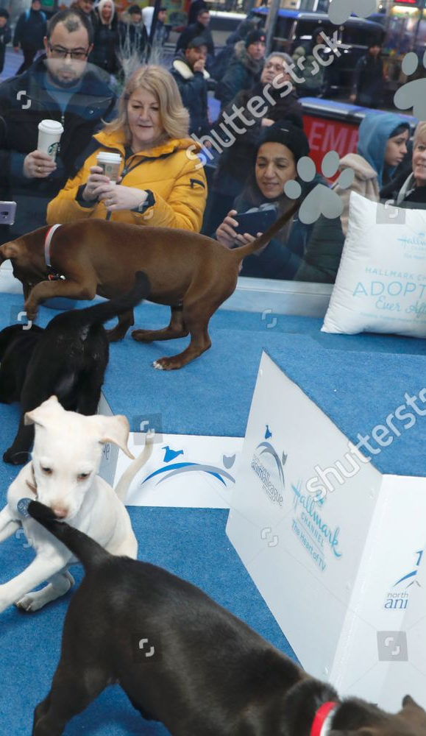
What is Experiential Adoption?
In an effort to get more interactive with their outreach campaigns, ad agencies and shelters are engaging in more experience-based adoption initiatives.
Getting consumers involved, particularly with social causes, can be challenging, prompting organizations like animal shelters to turn to experiential marketing tactics.
Pet adoption services turn to experiential tactics for increased involvement. Using pop-up shops and entertainment venues to add excitement to the adoption process, agencies are seeking to not only make the overall experience more interactive, but also to add a sense of intrigue to traditionally low-key social causes.

Slide 3

Experiential marketing is a marketing technique that creates experiences between brands and consumers. Experiential campaigns use an activation (for example product sampling, immersive experiences, stunts, events, etc.) to bring brands to life and interact directly with the target audience.
Experiential Adoption is one of the many strategies employed in experiential marketing

Slide 4
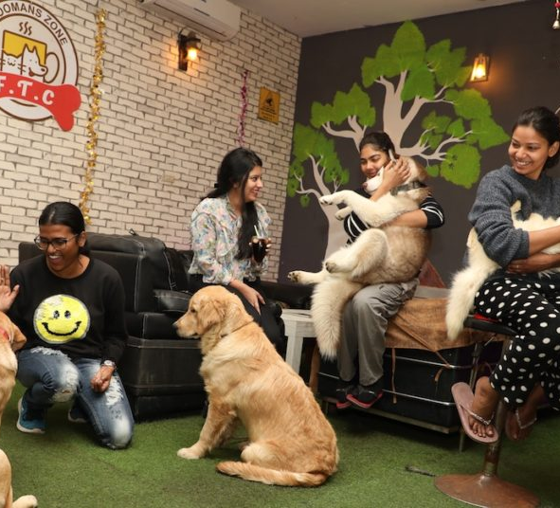
Animal Cafés, also known as Pet Cafés have been very popular since it was first established in Taiwan in 1998 was primarily for people who wanted to spend time with animals and at the same time enjoy some drinks and food.
Shelters and rescuers are always looking for new ways for homeless pets to interact with potential adoptive families. They have worked to create open and inviting areas where people can have one-on-one time with pets before deciding to adopt, working to change the stereotypes about shelter pets

Slide 5
Pets in the European Union
While dogs were globally speaking the most common type of pet, cats were more common in the European Union in 2018. Roughly 75 million people within this region had a pet cat in 2018, compared to the 65 million pet dogs. Germany had about nine and a half million pet dogs, making it the country with the highest number within the European Union. Other top dog-loving countries included the United Kingdom, Poland, and France.
Besides cats and dogs, Germans had many other household pets in 2018. About five and a half million small pets, such as hamsters and rabbits, were kept by Germans that year. Additionally, about two million households in Germany owned an aquarium and roughly one and a half million households owned a garden pond.

Slide 6
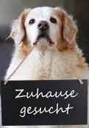
What is a Tierheim?
Tierheim literally means animal (‘tier’) house(‘heim’).
An animal shelter or pound is a place where stray, lost, abandoned or surrendered animals — mostly dogs and cats — are housed.
The shelters take care of a wide variety of common and exotic animals—roughly 10,000 to 15,000 annually. 60% of the animals are taken in because of the loss of their owner or accommodation, while 40% of them are rescued or are strays whose owner can’t be identified.
Though Tierheim shelter over 10,000 animals annually, the adoption rate goes far beyond 90%. However, this doesn’t mean the criteria for adoption are loose.

Slide 7


Experiential Adoption thru Pet Cafes
Goal:
aim to find an optimal location to establish Pet Cafes in North Germany. This report targets entrepreneurs or NGO's interested in opening a business with a social cause, specifically in Animal welfare.
help Animal Shelters in promoting animal adoption and fostering
target shelters in districts where there is a bigger population and with a better accessibility in terms of public transport.
A ranking of optimal venues will be done which will give us a better suggestion where to establish Cafes.

Slide 8
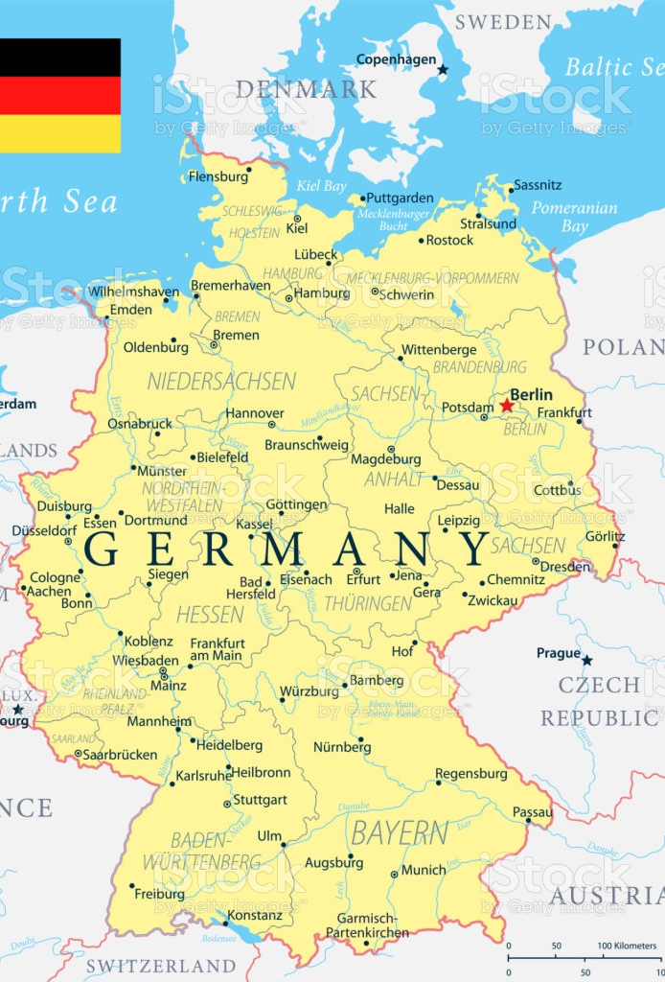
Introduction to North Germany
North Germany ^{[1]} is the region in the northern part of Germany, whose exact area is not precisely or consistently defined. It varies depending on whether one has a linguistic, geographic, socio-cultural or historic standpoint. The following five coastal states are regularly referred to as Northern Germany
Schleswig-Holstein,
Mecklenburg-Vorpommern,
Lower Saxony (Niedersachsen)
city-states Hamburg and Bremen

Slide 9
Data Gathering
A list of postal regions and codes can be found in suche-postleitzahl.org. The list in suche-postleitzahl gives a more detailed list of all the neighborhoods and their corresponding postal codes and population. The data can be downloaded as jpeg, csv, or excel hence this site came in very handy.
The geospatial coordinates were gathered thru OpenDataSoft(ODS)[4] website. ODS listed coordinates together with the postal codes for better accuracy.

Slide 10
Methodology 1.Data Analysis
Top districts were selected based on population distribution. Candidate districts were extracted from each State in order to have a proper representation for each state in North Germany.
City States Hamburg and Bremen are also included in the selection
Based on the Data gathered, the top candidates for North Germany are as follows:
Hamburg
Bremen
Hannover (Niedersachsen)
Osnabrück (Niedersachsen)
Göttingen (Niedersachsen)
Mecklenburgische Seenplatte (Mecklenburg-Vorpommern)
Vorpommern-Greifswald (Mecklenburg-Vorpommern)
Landkreis Rostock (Mecklenburg-Vorpommern)
Pinneberg (Schleswig-Holstein)
Rendsburg-Eckernförde (Schleswig-Holstein)
Kiel(Schleswig-Holstein)

Slide 11
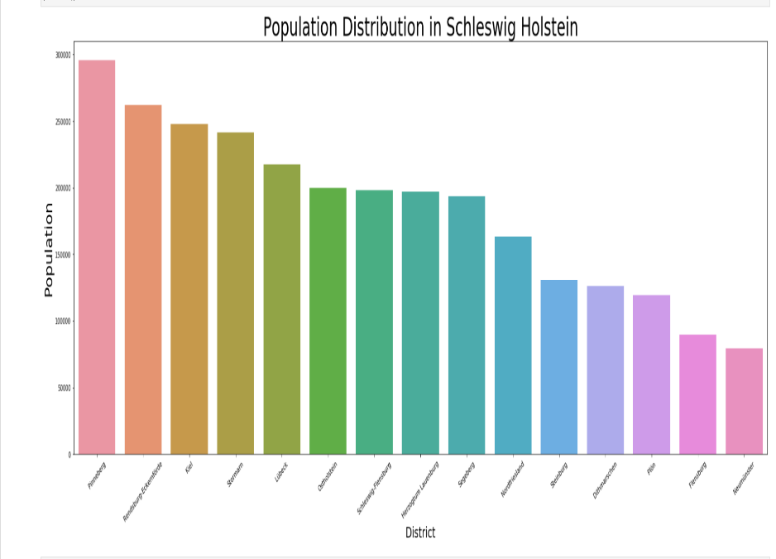

Slide 12
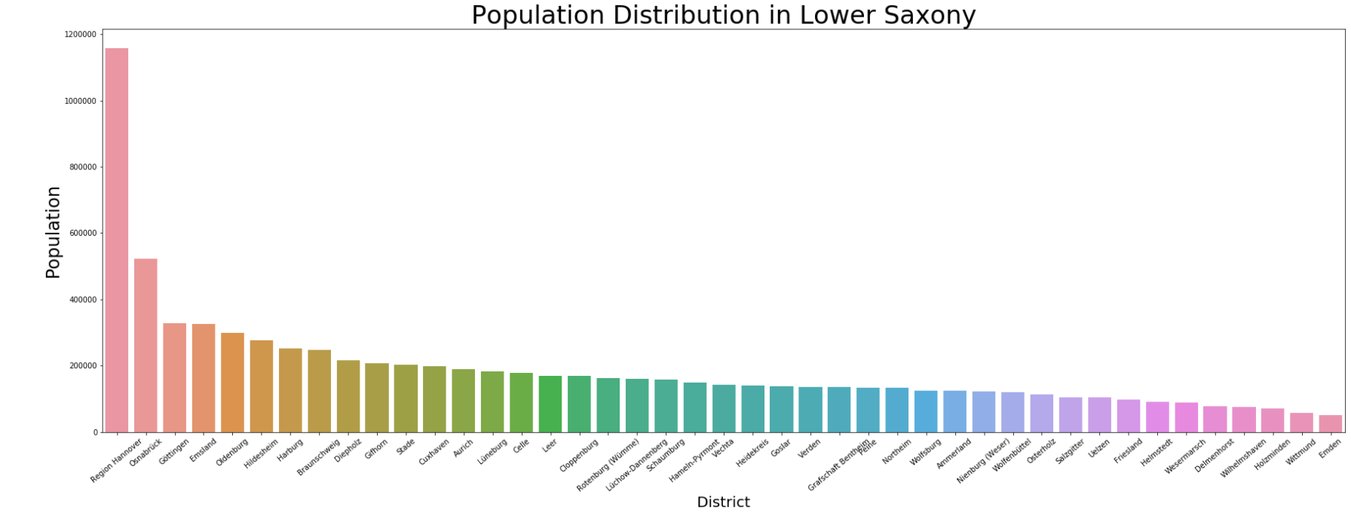

Slide 13
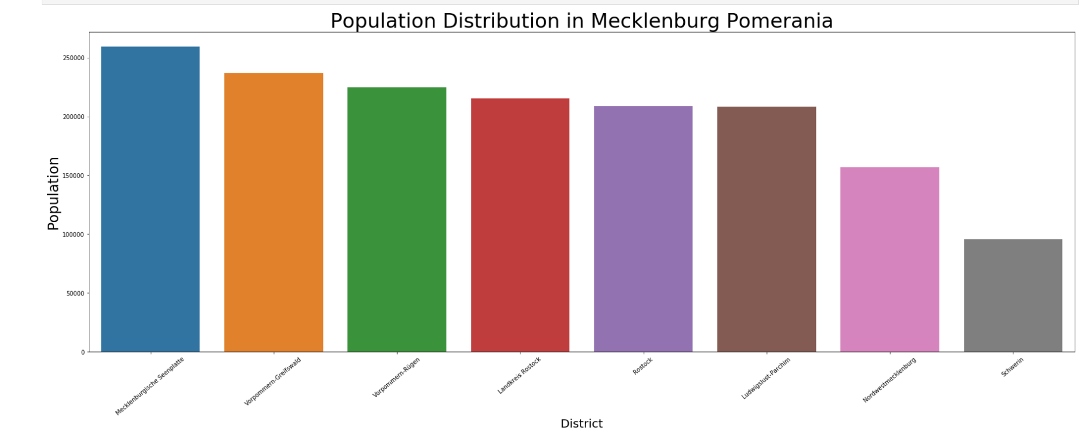

Slide 14
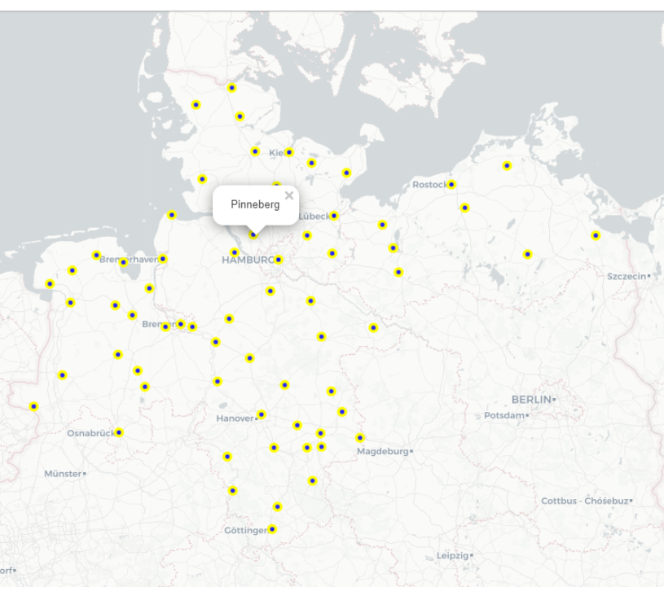
2. Map Visualization
Folium makes it easy to visualize data that’s been manipulated in Python on an interactive leaflet map. It enables both the binding of data to a map for choropleth visualizations as well as passing rich vector/raster/HTML visualizations as markers on the map. In this project, folium map is used to visualize the Districts of North Germany. The feature for a pop-up is also added so that when we hover and click on the label, the name of the District is displayed.

Slide 15
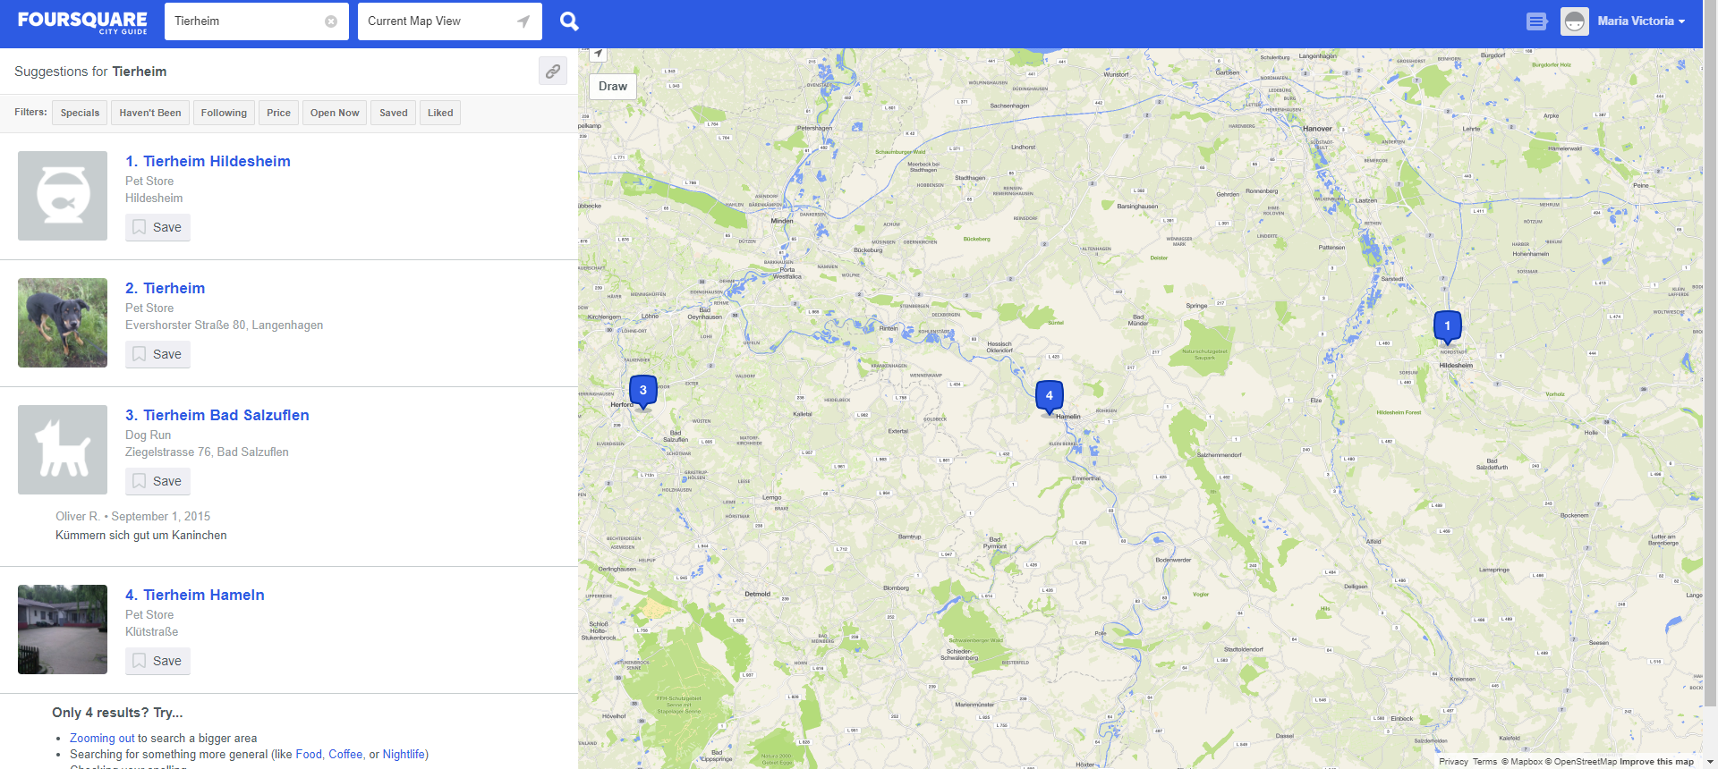
3.Foursquare
Foursquare City Guide, commonly known as Foursquare, is a local search-and-discovery mobile app developed by Foursquare Labs Inc. The app provides personalized recommendations of places to go near a user's current location based on users' previous browsing history and check-in history.

Slide 16
4. Analysis of Foursquare Data
The response format yielded is JSON, hence the data might not make sense if you try to decipher it without cleaning the data and importing it as a data frame. Once the data is cleaned, we get a better picture of the details included in the search
In this data, the address, as well as the latitude and longitude were included. But this are not the only details that you can obtain thru Foursquare. There are other functions such as getting tips, rating and photos for selected venues.

Slide 17
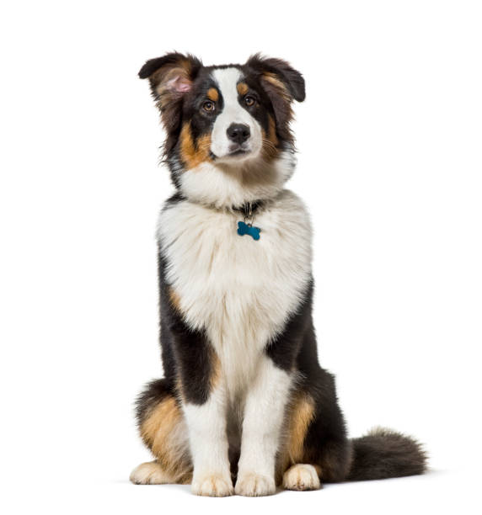
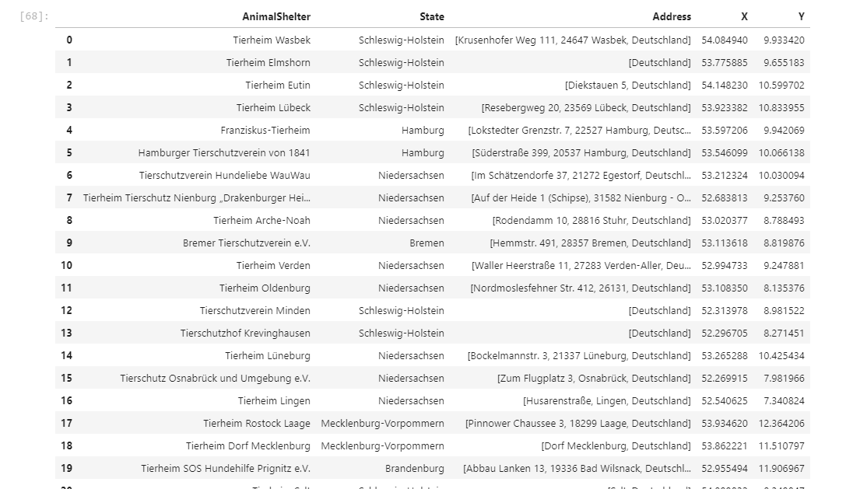
List of Animal Shelters in North Germany

Slide 18
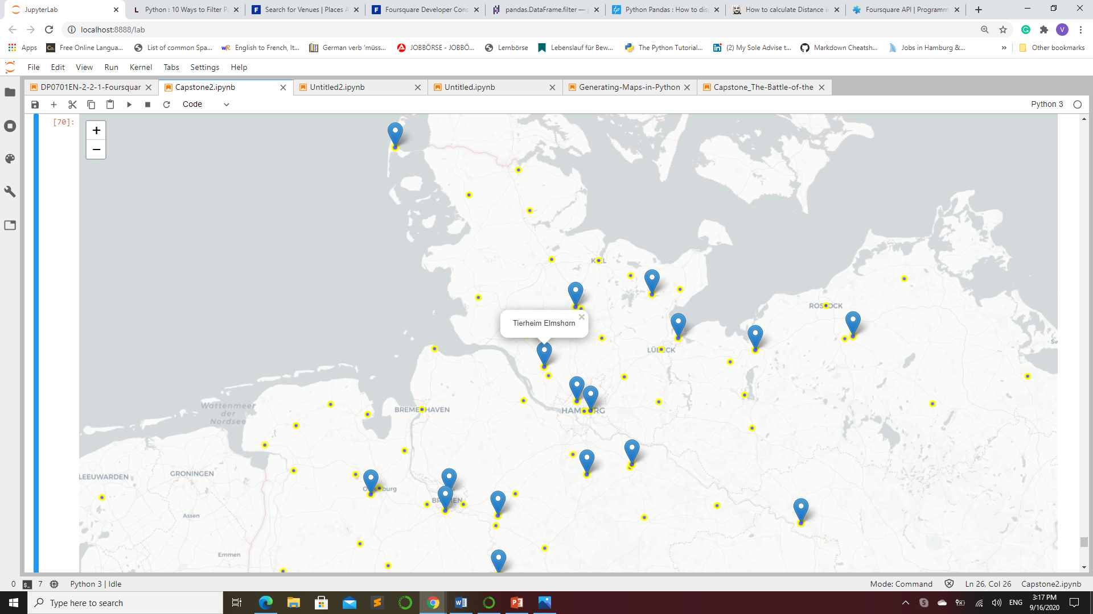
Animal Shelters in North Germany

Slide 19
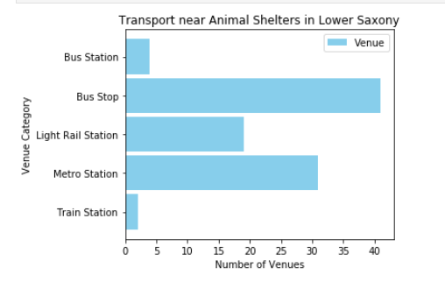
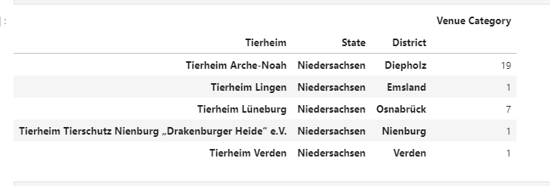
Transportation Venues
Here we see the number of transportation facilities available nearby the animal shelters in Lower Saxony (Niedersachsen).

Slide 20
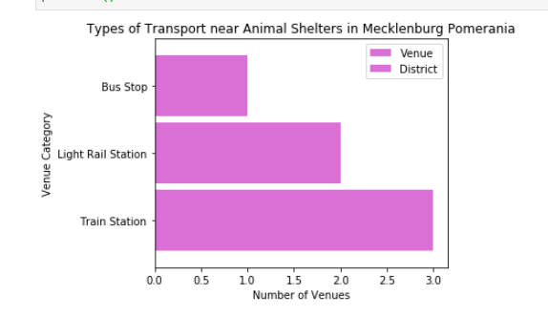
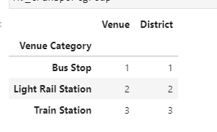
Mecklenburg- Pomerania

Slide 21
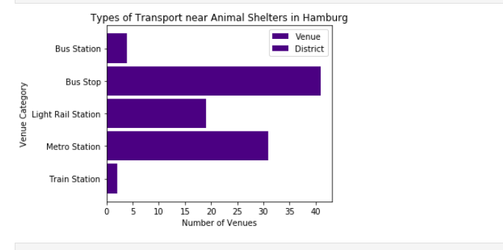
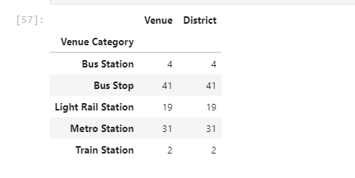
Hamburg

Slide 22
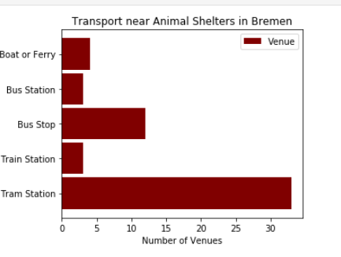
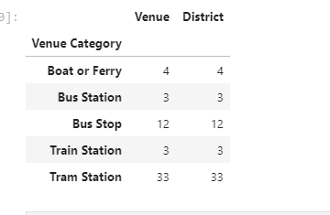
Bremen

Slide 23
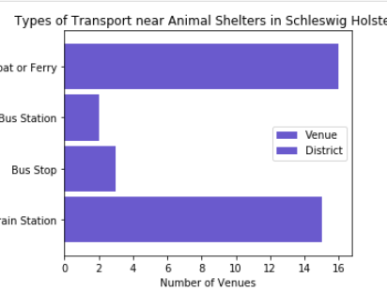
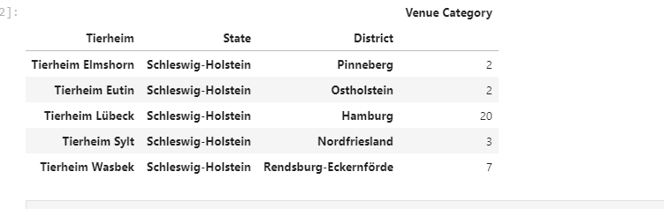
Schleswig-Holstein

Slide 24
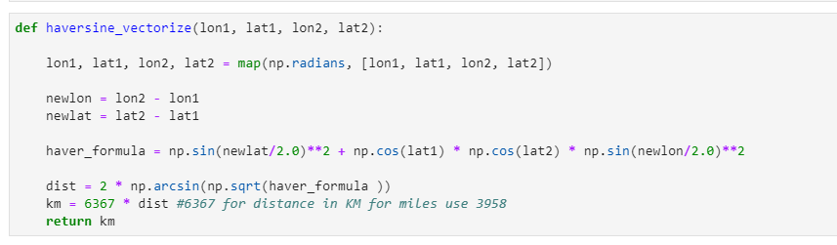
Data Analysis
Using Haversine Formula to calculate distance
This uses the ‘haversine’ formula to calculate the great-circle distance between two points – that is, the shortest distance over the earth’s surface – giving an ‘as-the-crow-flies’ distance between the points.

Slide 25
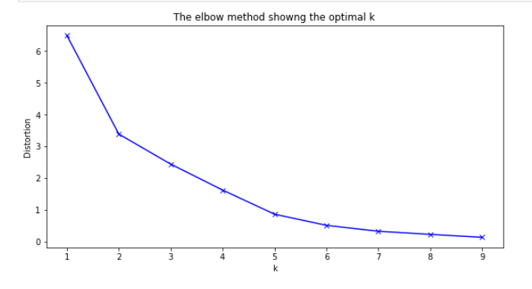
K-means clustering
In cluster analysis, the 'elbow method' is a heuristic used in determining the number of clusters in a data set. The method consists of plotting the explained variation as a function of the number of clusters and picking the elbow of the curve as the number of clusters to use. The same method can be used to choose the number of parameters in other data-driven models, such as the number of principal components to describe a data set
Using K-means clustering, we get a list of the Most Common Venues for each of District

Slide 26
Exploring Clusters
Cluster 0
1. Comprised of 7 Districts, Emsland, Osnabrück, Verden, Bremen, Diepholz, Lüneberg and Nienburg
2. Foursquare returned 4 similar transportation categories for each district namely: Train Station, Bus Stop, Boat or Ferry,and Tram Station.
3. Out of all these categories, the cluster's main similarities is derived from the list of " Most common venues". As you may notice, the districts above have the same top 3 rankings for the "most common venues“
Cluster 1
1. Comprised of 5 Districts: Nordfriesland, Minden-Lübecke, Lübeck, Ostholstein, Pinneberg, and Rendsburg-Eckernförde.
2. Foursquare returned 4 similar transportation categories for each district namely: Train Station, Bus Stop, Boat or Ferry, Bus Station.
3. Out of all these categories, the cluster's main similarities is derived from the list of " Most common venues". As you may notice, the districts above have the same top 3 rankings for the "most common venues"

Slide 27
Cluster 2
1. Comprised of only 1 District: Brandenburg
2. Foursquare Train Station for the unique category for this district
Cluster 3
1. Comprised of only one District:Hamburg.
2. Foursquare returned 5 similar transportation categories for each district namely: Train Station, Bus Stop, Metro Station, Bus Station, Light rail station.
3. Out of all these categories, the cluster's main similarities is derived from the list of " Most common venues". As you may notice, the districts above have the same top 3 rankings for the "most common venues“
Cluster 4
1. Comprised of only one District: Mecklenburg-Vorpommern.
2. Foursquare returned 3 similar transportation categories for each district namely: Train Station, Bus Stop, Light rail station.
3. Out of all these categories, the cluster's main similarities is derived from the list of " Most common venues". As you may notice, the districts above have the same top 3 rankings for the "most common venues"

Slide 28
Results and Discussion
Our analysis shows that although our selected land Area is big, the number of Animal Shelters yielded were only a few. The venues for these shelters are also not close to the city centers, most of them are in remote villages-most likely to be able to accommodate space and not to disturb residential areas. Being in remote areas will also help their animals to be more at rest.
Although there are a lot of transportation facilities available around the Animal Shelters, most of them are situated approximately around 1 km away from the Shelter. At most, one bus stop is ~500 meters from the Animal Shelter in Hamburg. Most of the Shelters are more accessible thru use of private vehicles. Train Stations are even further with approximates ~5km distance from each Shelter.
Interestingly, some Shelters can be accessed by Boat and Ferry. Most of which are located near the coast.
Recommended zones should therefore be considered only as a starting point for more detailed analysis which could eventually result in location which has not only no nearby competition, but also other factors taken into account and all other relevant conditions met.
It is also noteworthy that as compared with Foursquare, Google maps had yielded more results for Animal Shelters using the ‘Search Nearby’ option. This might be attributed to the fact that Foursquare is not popularly used in Germany.

Slide 29
Conclusion
The purpose of this project was to identify areas in North Germany with Animal Shelters close to transportation services and with a good population distribution in order to aid stakeholders in narrowing down the search for optimal location for a new Pet Cafe. By acquiring Animal Shelter venues from Foursquare and the Population data from each District, we have identified the top Districts that justify further analysis
We then generated extensive collection of transportation locations which satisfy some basic requirements regarding nearby transportation services. Clustering of those locations was then performed in order to create areas of interest and addresses were created to be used as starting points for final exploration by stakeholders

